Slide 1
OPTICAL COMMUNICATION SYSTEMS PROJECT REVIEW 1
BY
SANTHOSH KUMAR S - 21BEC1283
PATHI DISHITHA - 21BEC1329
AAKASH - 21BEC1138

Slide 2
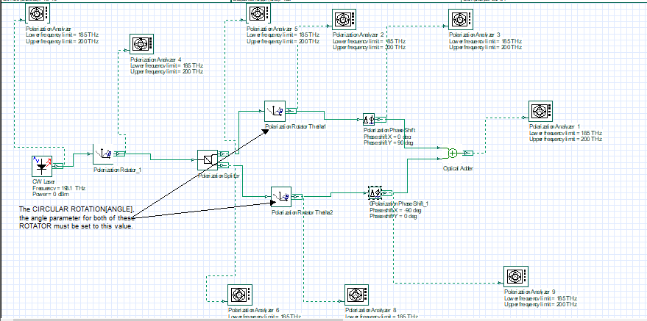
CIRCULAR ROTATION USING OPTISYSTEM

Slide 3
AIM
The aim of the experiment described, which involves a continuous wave (CW) laser, a polarization rotator, a polarization splitter, two polarization thetas, polarization phase shifters, and an optical adder, connected to a polarization analyzer, is to manipulate and analyze the polarization states of light. This setup is designed to explore the behavior of light under various polarization transformations and to observe the effects of phase shifting on the polarization states. The expected output of the experiment would provide insights into the properties of light polarization, the effects of phase shifting, and the performance of optical components in manipulating light polarization.

Slide 4
COMPONENTS USED
CW Laser: Serves as the light source, providing a continuous wave of light that can be manipulated through the optical system.
Polarization Rotator: Rotates the polarization state of the incoming light by an arbitrary angle. This is crucial for aligning the polarization state of the light with the requirements of the subsequent components or for creating specific polarization states for analysis ².
Polarization Splitter: Splits the incoming light into two linearly polarized beams with orthogonal polarization vectors. This is essential for separating the light into different polarization states, which can then be manipulated independently ².
Polarization Theatas: These are likely meant to be polarization analyzers or detectors, which measure the polarization state of the light. The term "theatas" might be a typo or a specific term used in the context of the experiment.
Polarization Phase Shifters: Introduce a phase shift to the polarization state of the light, altering the phase relationship between the orthogonal components of the light. This can be used to create specific polarization states or to test the sensitivity of the system to phase shifts.
Optical Adder: Combines the light from the two polarization theatas, allowing for the analysis of the combined polarization state.
Polarization Analyzer: Analyzes the polarization state of the combined light from the optical adder. This component is crucial for observing the final polarization state of the light after all the manipulations and for verifying the performance of the optical system.

Slide 5
DESCRIPTION
In this project we create a comprehensive software solution that can accurately model the behavior of optical signals as they undergo circular rotation within an optical system. The project will include the design and implementation of algorithms and modules that can simulate the circular rotation of optical signals, considering factors such as signal propagation, polarization effects, and potential applications in optical communication and sensing. The software will likely incorporate features to model optical components such as fiber optic cables, lenses, phase modulators, and other relevant devices to accurately represent the physical behavior of the system. Additionally, the software project will involve the development of a user interface to facilitate the configuration of simulation parameters, visualization of results, and analysis of the circular rotation effects on optical signals. The goal is to create a versatile and powerful software tool within OptiSystem that can be used for research, development, and optimization of circular rotation-based optical systems for various real-world applications. The main focus will be on ensuring the accuracy and reliability of the simulation results, as well as providing a user-friendly interface to enable researchers and engineers to explore the behavior of circularly rotated optical signals effectively.

Slide 6
OUTPUT VALUES EXPECTED
The expected output of the experiment would include:
Polarization State Analysis: The polarization analyzer would provide detailed information about the polarization state of the light at various points in the system, including before and after the manipulations by the polarization rotator, splitter, phase shifters, and adder. This analysis would help in understanding how the light's polarization state changes as it passes through the system.
Phase Shift Effects: Observations of how the phase shifters affect the polarization state of the light would provide insights into the sensitivity of the system to phase shifts and the ability of the system to maintain or alter the polarization state under different conditions.
Combined Polarization State: The analysis of the combined polarization state from the optical adder would reveal the final polarization state of the light after all the manipulations, providing a comprehensive view of the system's performance in terms of polarization state manipulation.

Slide 7
RESULT
This experiment is designed to explore the fundamental principles of light polarization and the behavior of optical components in manipulating light polarization states. The results would contribute to a deeper understanding of optical systems and their applications in various fields, including telecommunications, optical computing, and quantum information processing.

Slide 8
THANK YOU

